Slide 1
NAND-ONLY LOGIC CIRCUITS
• Any logic circuits can be transformed to an implementation where only NAND gates (and inverters) are used.
• The general approach to finding a NAND-gate realization: Use DeMorgan’s theorem to eliminate all the OR operations.

Slide 2
NAND-ONLY LOGIC CIRCUITS
(Example)
F = A + B • (C + D’)
= A + B • (C’D)’
Note that (C’D)’ = C + D’ and (A’X’)’ = A + X
F = (A’ • (B • (C’D)’)’)’
Now there is no OR operation in the Boolean expression. Note that
A NAND B = (AB)’

Slide 3
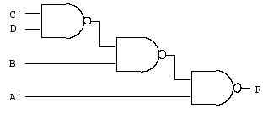
F= (A’ • (B • (C’D)’)’)’
The logic circuit for this function is given by:
We can also use the same procedure to do NOR only gates.

Slide 4
Ch2. Decoder
Dr. Bernard Chen Ph.D.
University of Central Arkansas
Spring 2009

Slide 5
Integrated Circuits
An integrated circuit is a piece (also called a chip) of silicon on which multiple gates or transistors have been embedded
These silicon pieces are mounted on a plastic or ceramic package with pins along the edges that can be soldered onto circuit boards or inserted into appropriate sockets

Slide 6
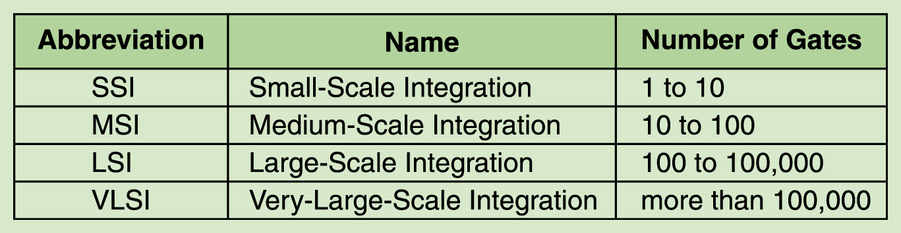
Integrated Circuits
SSI, MSI, LSI: They perform small tasks such as addition of few bits. small memories, small processors
VLSI Tasks: - Large memory - Complex microprocessors, CPUs

Slide 7
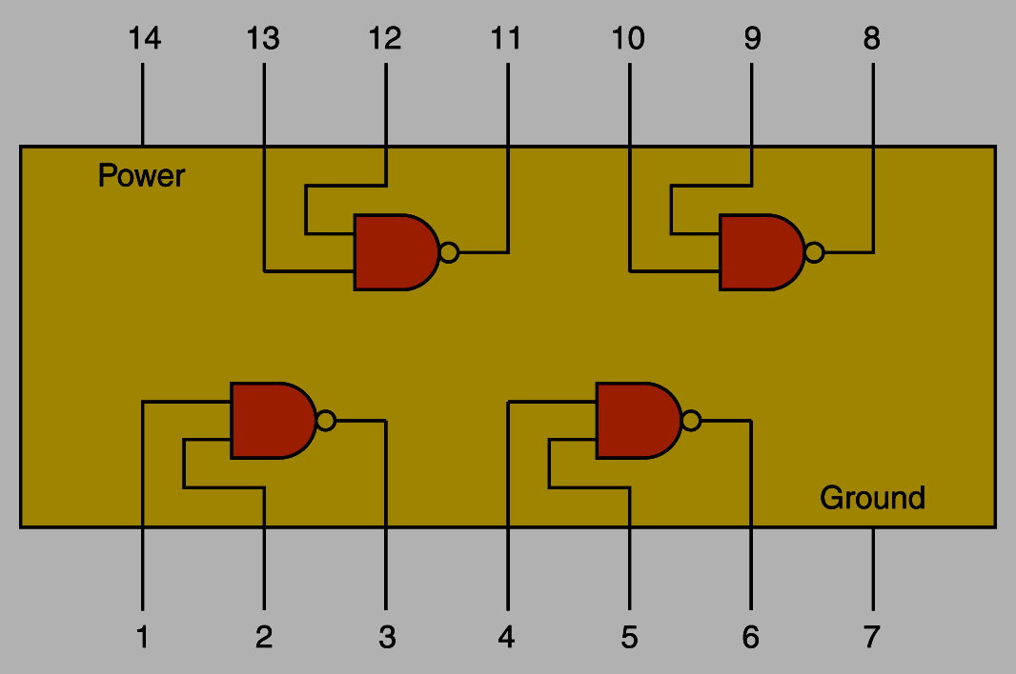
An SSI chip contains independent NAND gates

Slide 8
Examples of Combinational Circuits
a) Decoders
b) Encoders
c) Multiplexers
d) Demultiplexers

Slide 9
Decoder
  Accepts a value and decodes it
    Output corresponds to value of n inputs
  Consists of:
    Inputs (n)
    Outputs (2^{n} , numbered from 0 → 2^{n} - 1)
    Selectors / Enable (active high or active low)

Slide 10
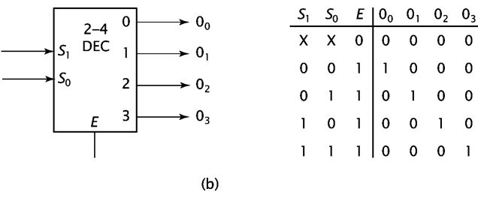
The truth table of 2-to-4 Decoder

Slide 11
2-to-4 Decoder

Slide 12
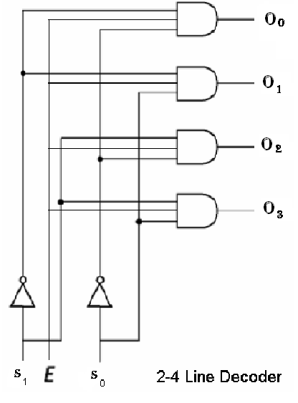
2-to-4 Decoder

Slide 13
The truth table of 3-to-8 Decoder
A2 | A1 | A0 | D0 | D1 | D2 | D3 | D4 | D5 | D6 | D7
0 | 0 | 0 | 1
0 | 0 | 1 |  | 1
0 | 1 | 0 |  |  | 1
0 | 1 | 1 |  |  |  | 1
1 | 0 | 0 |  |  |  |  | 1
1 | 0 | 1 |  |  |  |  |  | 1
1 | 1 | 0 |  |  |  |  |  |  | 1
1 | 1 | 1 |  |  |  |  |  |  |  | 1

Slide 14
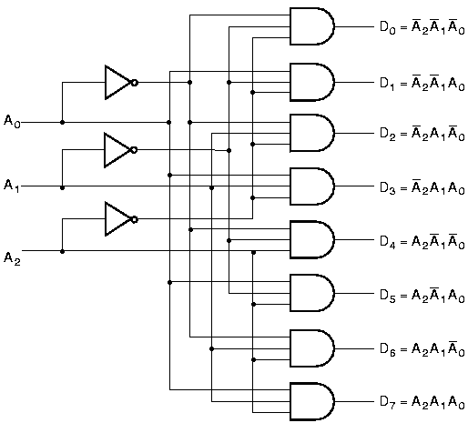
3-to-8 Decoder

Slide 15
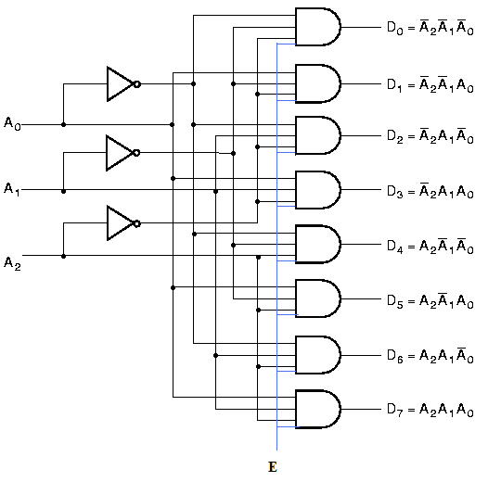
3-to-8 Decoder with Enable

Slide 16
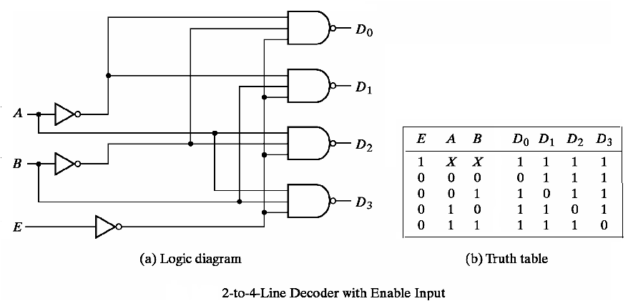
2-to-4 Decoder: NAND implementation
Decoder is enabled when E=0 and an output is active if it is 0

Slide 17
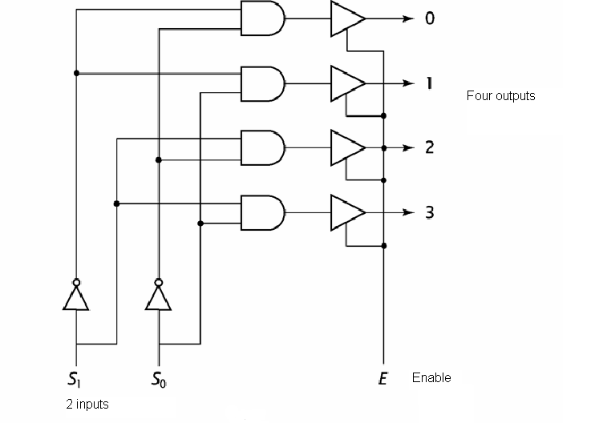
2-4 Decoder with 2-input and Enable

Slide 18
Decoder Expansion
Decoder expansion
  Combine two or more small decoders with enable inputs to form a larger decoder
  3-to-8-line decoder constructed from two 2-to-4-line decoders
    The MSB is connected to the enable inputs
    if A₂=0, upper is enabled; if A₂=1, lower is enabled.

Slide 19
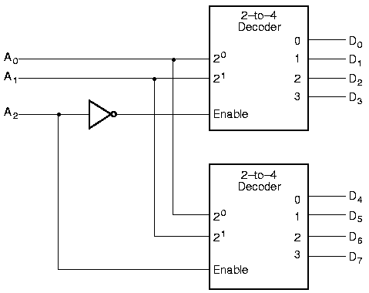
Decoder Expansion

Slide 20
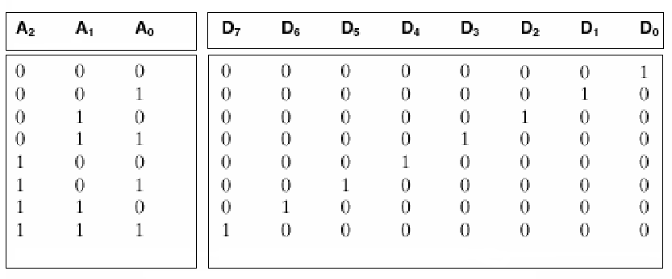
Combining two 2-4 decoders to form one 3-8 decoder using enable switch
The highest bit is used for the enables

Slide 21
Combinational Circuit Design with Decoders
Combinational circuit implementation with decoders
  A decoder provide 2^{n} minterms of n input variables
  Since any Boolean function can be expressed as a sum of minterms, one can use a decoder and external OR gates to implement any combinational function.

Slide 22
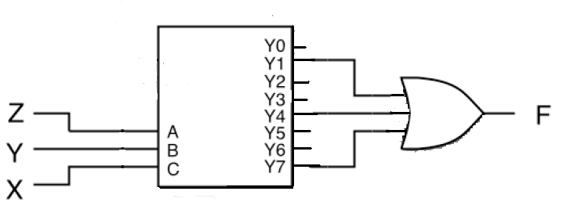
Combinational Circuit Design with Decoders
Example Realize F (X,Y,Z) = Σ (1, 4, 7) with a decoder:

